Slide 1
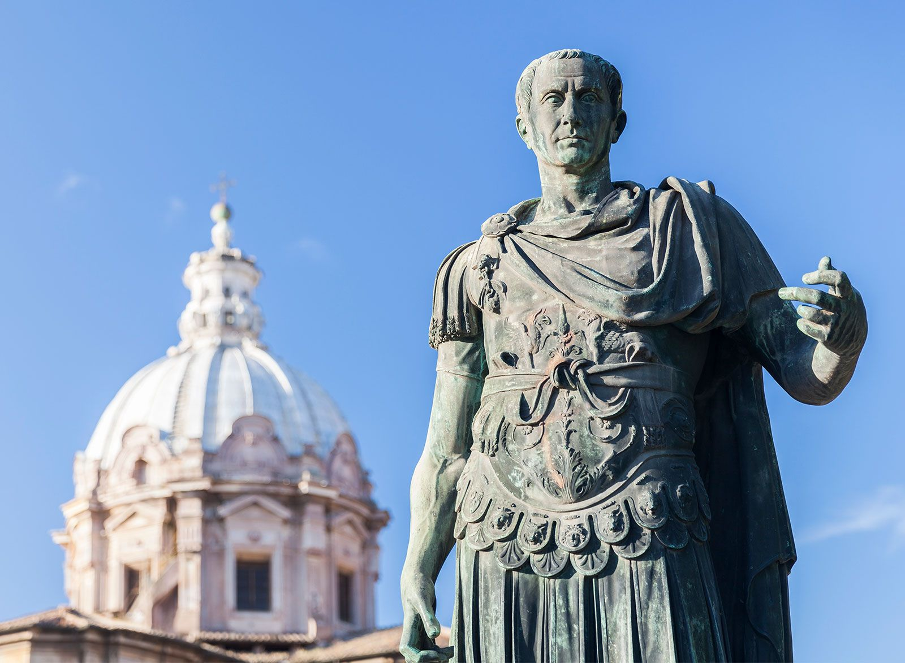
Revision 2
Revise key ideas, events, people – Julius Caesar
Week 8 Lesson 2
Ms Barrie

Slide 2
Instructions
Revise key content regarding Julius Caesar.
Use the revision sheet provided to practice responses.
If you finish early, complete private study.

